Slide 1
Eh Eye
Team member:
Yong hao
Vibin
Shawn

Slide 2
Which day has the highest mean value?

Slide 3
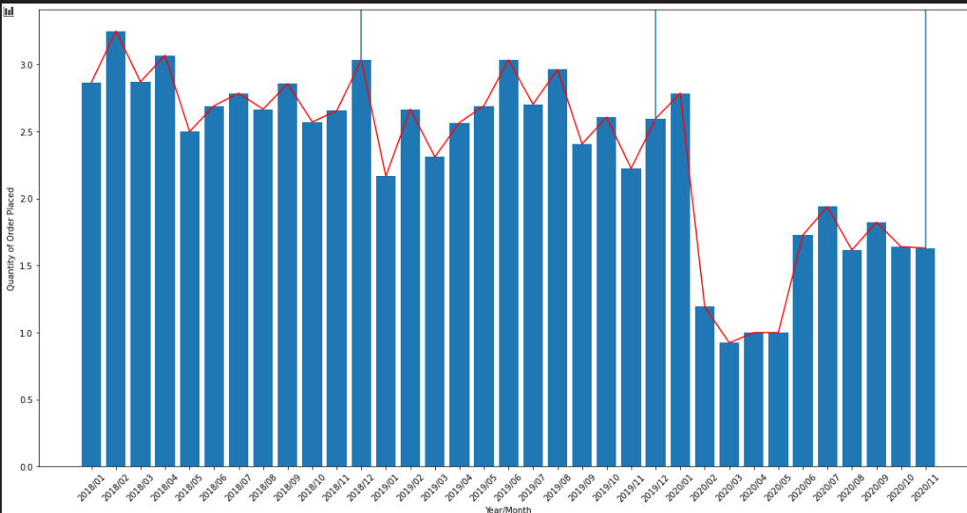
Overall Monthly Trend

Slide 4
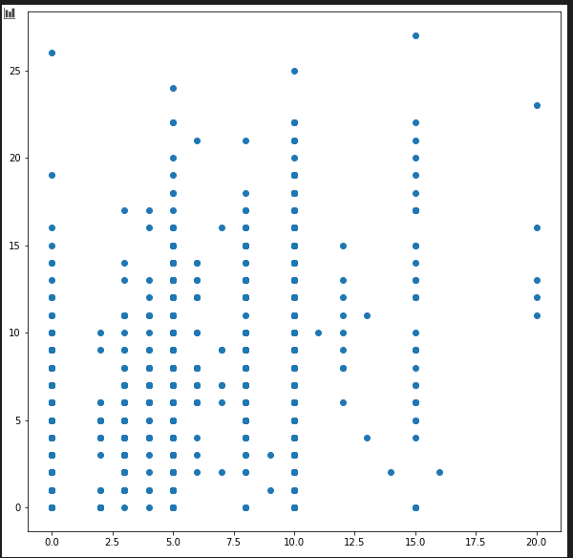
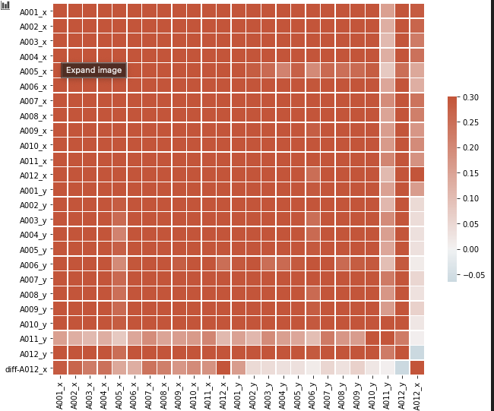
Why linear regression cannot use?

Slide 5
Prophet
an open-source library designed for making forecasts for univariate time series datasets

Slide 6
Trends

Slide 7
LIVE demo

